Slide 1
Fast Minimum Spanning Tree for Large Graphs on the GPU
A project for the advanced algorithm and parallel programming
Based on the homonymous paper published by Vibhav Vineet, Pawan Harish, Suryakanth Patidar, P J Narayanan
D.Parravicini (10527346) Academic year 2018-2019

Slide 2
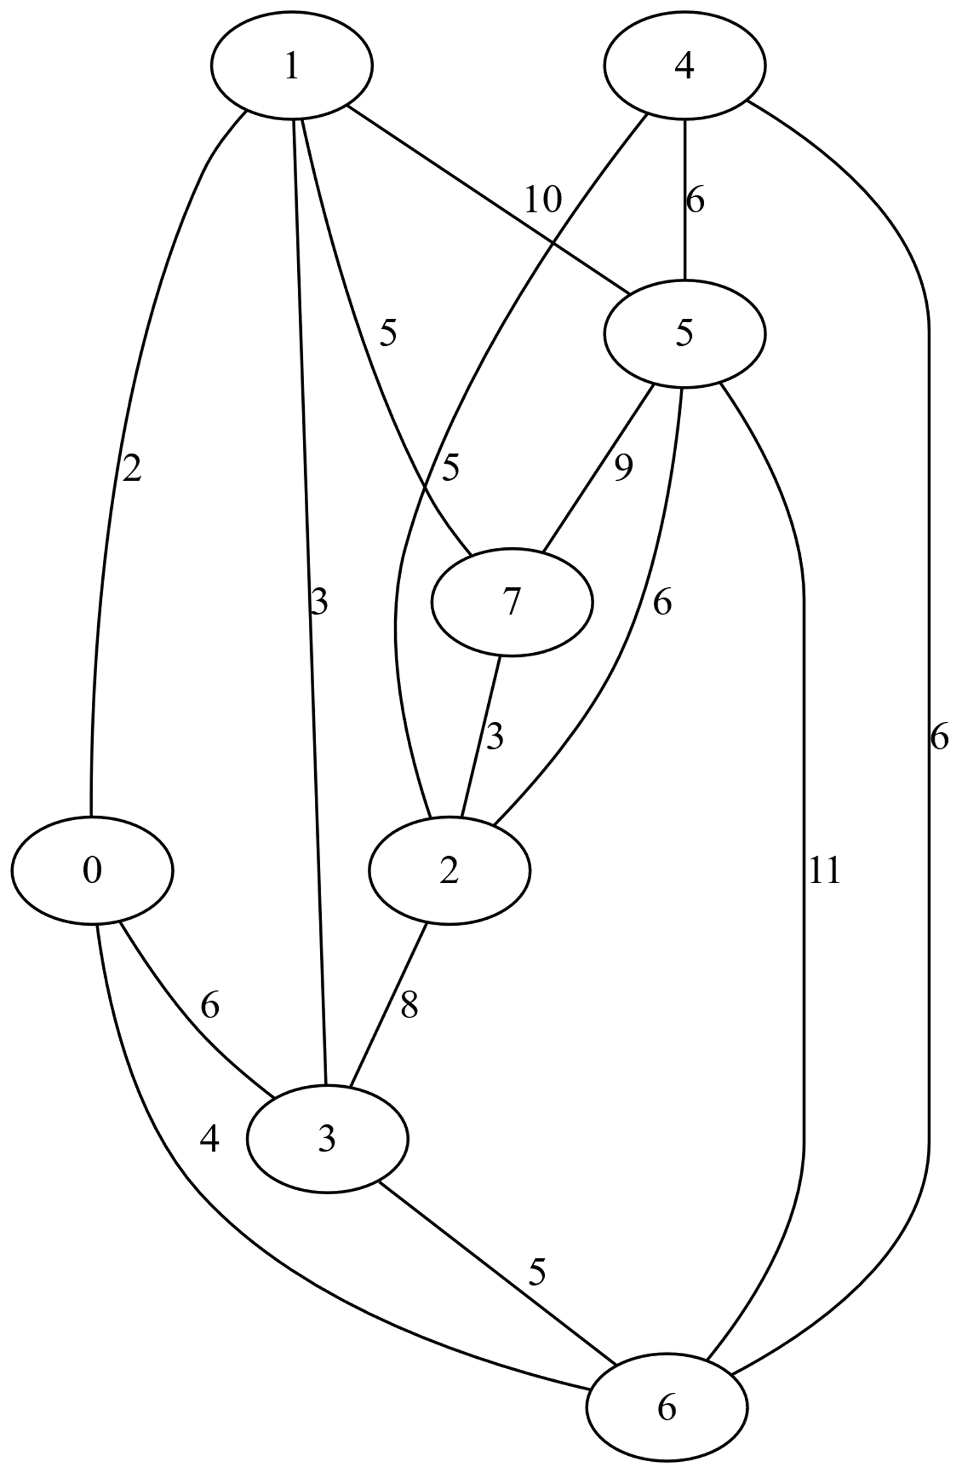
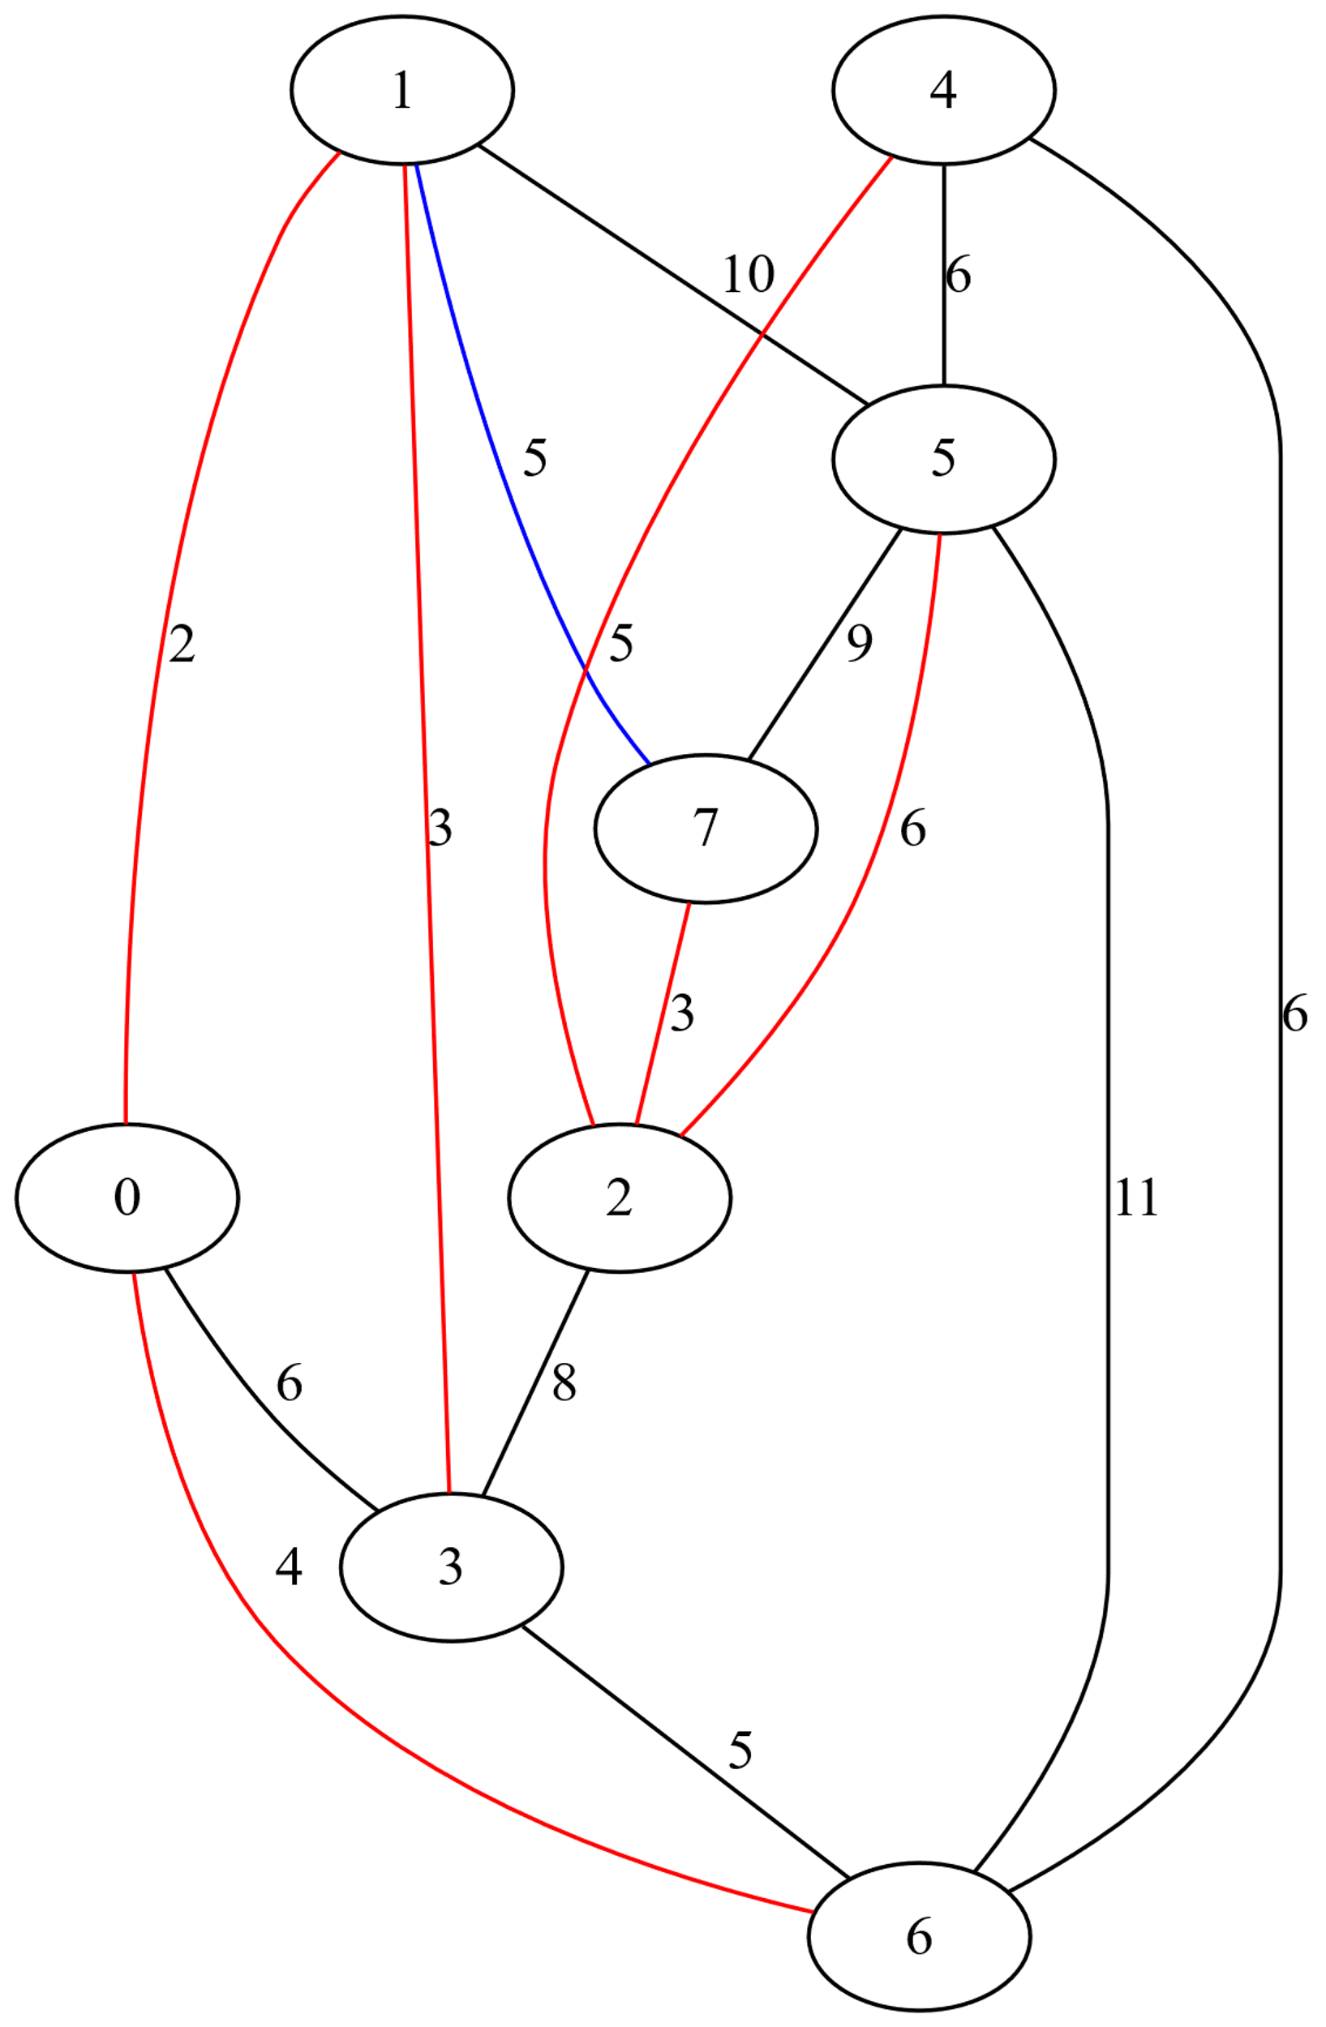
Minimum spanning tree

Slide 3
Modification proposed on top of the standard algorithm
Since CUDPP is not aymore mantained I exploit the primitives exposed by thrust library :
thrust::(ex)inclusive_scan(_by_key) -> scan/segented_scan
thrust::sort_by_key -> split
thrust::gather
thrust::scatter
instead of having to rebuild at any iteration the vertices source for each edge in the data structure vertices are saved in an «extended» form
An iterative approach instead of a recursive one

Slide 4
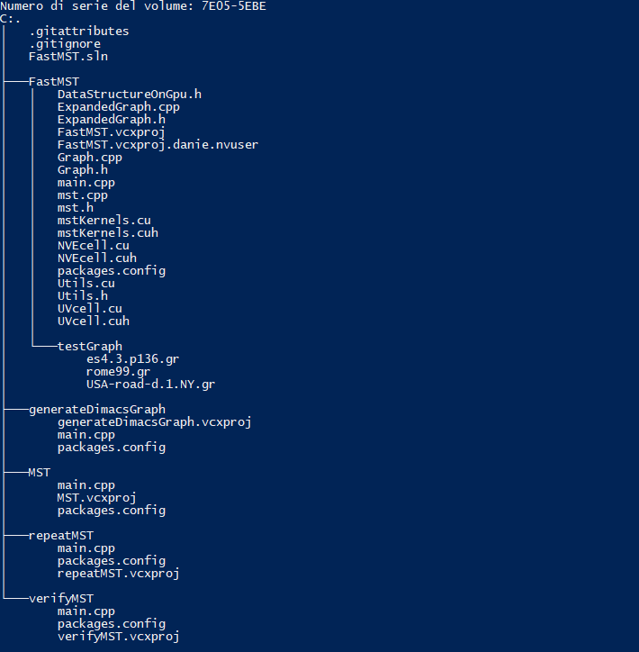
How the project is organized
The project functionalities are spread accross different executable.
Each of them simply recall a functionality that is exposed by means of a static library. The static library is the core of the project.

Slide 5


How the program works
Almost all program takes as an argument a graph expressed in DIMAC challenge 9 format.

Slide 6
Performances (Commit 898659e2)
Data were collected on a GeForce GTX 1060 6 GB @ 2016 (1506 MHz, 192 bit bus capable of 192.2 GB/s , TDP: 120 W , SM: 10)
While paper data were collected on a TESLA S1070 @ 2008 (610 MHz, 512 bit bus capable of 102.4 GB/s, TDP: 800W , SM: 30 ) according to source the performance of 1060 are 2.62 times higher

Slide 7
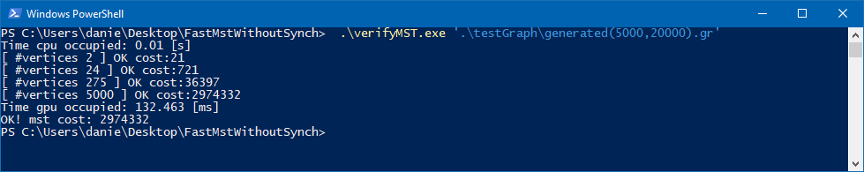
How to validate correctness

Slide 8
Criticize the paper
The number of bits dedicated to vertex identification were not enough for some of the DIMAC graphs ( e.g. in USA-road-d.W 2^22 = 4 194 304‬ < 6 262 104 )
The paper does not make clear assumptions on the algorithm (shall it work for forest of tree?)
Even in my project I took advantage of RMAT graph generator but the paper never reported the parameters that of the graph generator that could have influenced their results.
Not a lot of information on how to mark the minimum outgoing edges of the current iteration
In general the paper was not fully reproducible.

